Slide 1
todo
todo

Slide 2
CSS SUCKS

Slide 3
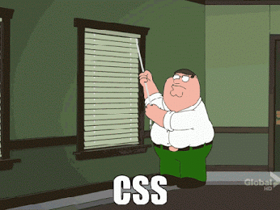

Slide 4
CSS is mostly experienced as difficult.
It is ☺
It is huge
Learned the wrong way
Because its not used as it should be

Slide 5
Cascading StyleSheets

Slide 6
CSS === Modules
CSS3 is not a specification like his predecessors
Built using modules
every module
own specification
own author

Slide 7
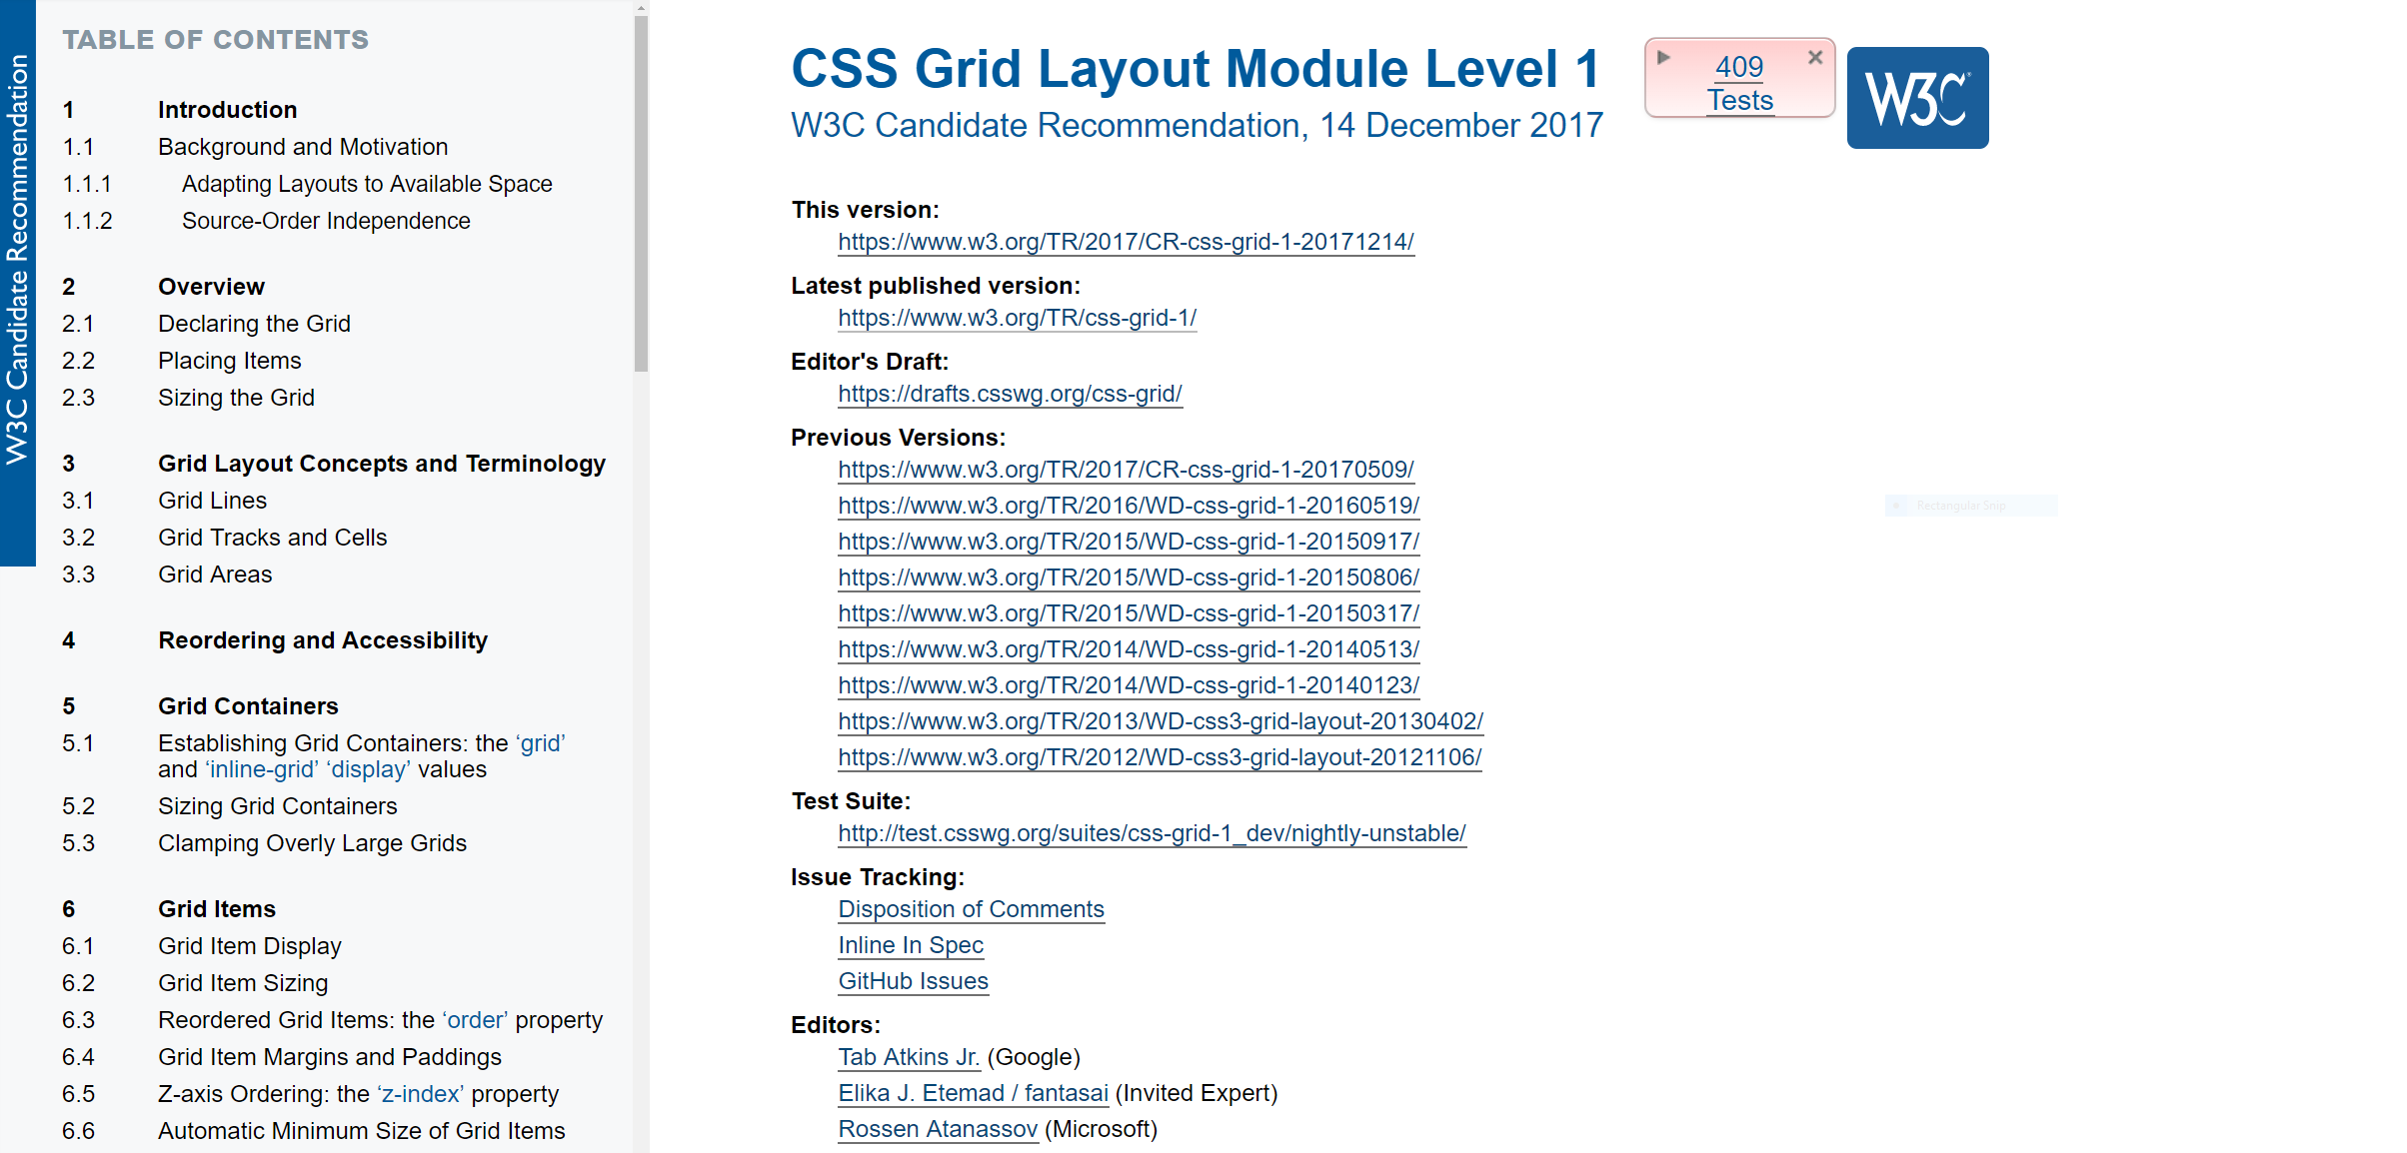

Slide 9
https://www.w3.org/Style/CSS/current-work.en.html

Slide 10
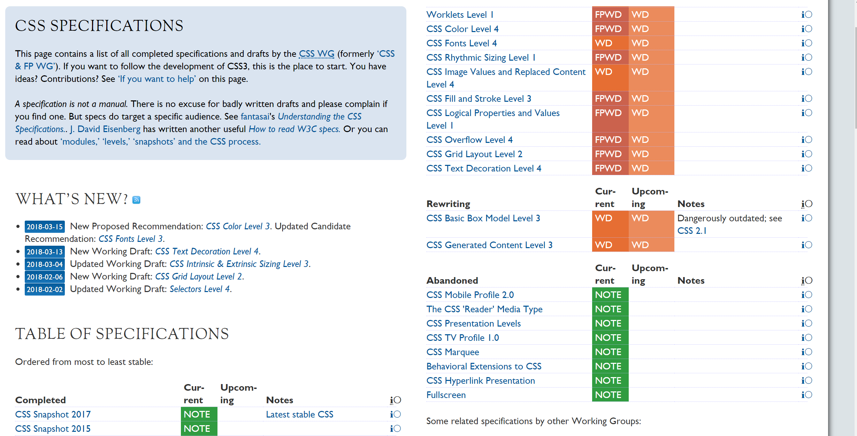

Slide 11
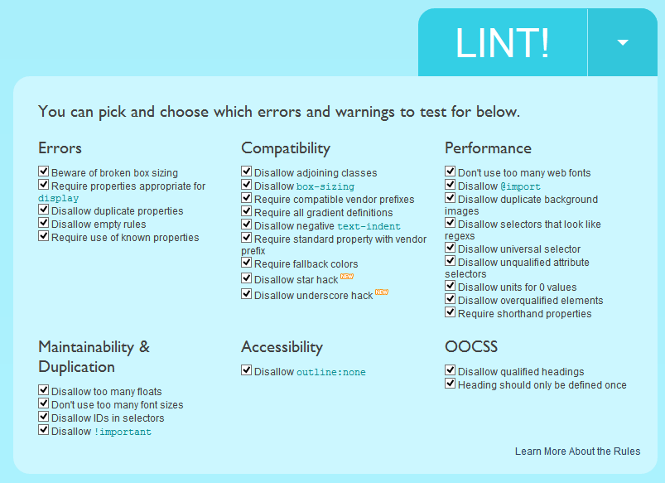

Slide 12
Adding CSS to your page
Inline or extern
TIP: always CSS extern
reusability
Performance via minification
Performance via caching
Working as a team

Slide 13
CSS
1
Box Model

Slide 14
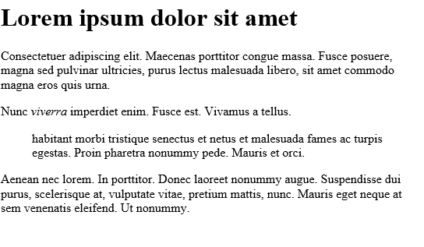
Think in blocks

Slide 15
Box Model
Each element is a rectangular box
CSS specifies
The size
Position
Properties
Each box is composed of 4 parts
Content
Padding
Border
Margin

Slide 16
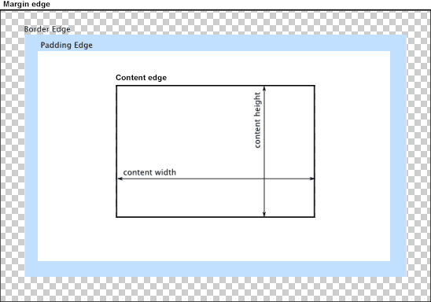

Slide 17
Box Model
Content area
The “real” content of the element
Dimensions are the content witdth and content height
Content-Box
Padding
Area between border and content
Padding-box
Border
Border-box

Slide 18
Box Model
Content area
The “real” content of the element
Dimensions are the content witdth and content height
Content-Box
Padding
Area between border and content
Padding-box
Border
Border-box

Slide 19
Box Model
Margin
Between border and the outside of the element
Margin-box

Slide 20
So what’s the problem
The witdth!
By default
Width: margin + border + padding + content
Not logical
https://developer.mozilla.org/en-US/docs/Web/CSS/box-sizing
Notes:
content-box gives you the default CSS box-sizing behavior. If you set an element's width to 100 pixels, then the element's content box will be 100 pixels wide, and the width of any border or padding will be added to the final rendered width.
border-box tells the browser to account for any border and padding in the values you specify for an element's width and height. If you set an element's width to 100 pixels, that 100 pixels will include any border or padding you added, and the content box will shrink to absorb that extra width. This typically makes it much easier to size elements.

Slide 21
html {
box-sizing: border-box;
}
*, *:before, *:after {
box-sizing: inherit;
}

Slide 22
Selecting blocks
CSS == select block + assign properties
Rule
Selector
declaration

Slide 23
CSS
2
Selectors

Slide 24
Selector
p {
font-family: Verdana;
}
Declaration

Slide 25
Property
p {
font-family: Verdana;
}
Value

Slide 26
Universal Selector
* {}
Selecteert elk element in het document

Slide 27
Type Selector
h1 {}
Selecteert elk element die matched met de naam

Slide 28
Type Selector
h1,h2,h3 {}
Selecteert elk element die matched met de naam

Slide 29
Class Selector
.active {}
Selecteert elk element die matched met de waarde van het class attribuut

Slide 30
ID Selector
#intro {}
Selecteert elk element die matched met de waarde van het ID attribuut

Slide 31
Child Selector
li > a{}
Selecteert elke <a> die <li> als rechtstreekse parent heeft

Slide 32
Descendant Selector
p a{}
Selecteert elke <a> die ergens voorkomt in een paragraaf

Slide 33
Adjacent Sibling Selector
h1 + p{}
Selecteert de eerste <p> die achter een <h1> tag komt

Slide 34
General Sibling Selector
h1 ~ p{}
Selecteert elke <p> die achter een <h1> tag komt, maar op het eerste niveau

Slide 35
Attribuut Selector
[title]
Selecteert alle elementen die het title attribuut bevatten

Slide 36
Attribuut Selector
[target=_blank]
Selecteert alle elementen die de waarde blank in het target attribuut hebben

Slide 37
Attribuut Selector
[href~=.jpg]
Selecteert alle elementen waarvan jpg in het href attribuut voorkomt

Slide 38
Attribuut Selector
[href*=.jpg]
Selecteert alle elementen waarvan jpg in het href attribuut voorkomt

Slide 39
Attribuut Selector
[href|=http]
Selecteert alle elementen waarbij de waarde van href start met http

Slide 40
Attribuut Selector
[href^=http]
Selecteert alle elementen waarbij de waarde van href start met http

Slide 41
Attribuut Selector
[href$=.jpg]
Selecteert alle elementen waarbij de waarde van het href attribuut eindigt met jpg

Slide 42
Pseudo class Selector
:link
Selecteert alle elementen, meestal a waarop nog niet geklikt is

Slide 43
Pseudo class Selector
:visited
Selecteert alle elementen, meestal a waarop wel geklikt is

Slide 44
Pseudo class Selector
:active
Selecteert alle elementen die momenteel actief zijn

Slide 45
Pseudo class Selector
:hover
Selecteert alle elementen waarop de muiscursor staat

Slide 46
Pseudo class Selector
:focus
Selecteert alle elementen, meestal input, die focus hebben

Slide 47
Pseudo class Selector
:first-letter
p:first-letter
Selecteert elke eerste letter

Slide 48
Pseudo class Selector
:first-line
p:first-line
Selecteert elke eerste lijn

Slide 49
Pseudo element Selector
:first-child
div:first-child
Selecteert het eerste element van een div

Slide 50
Pseudo element Selector
:before
div:before
Voegt content toe voor elk <div> element

Slide 51
Pseudo element Selector
:after
div:after
Voegt content toe achter elk <div> element

Slide 52
Pseudo element Selector
:nth-child(n)
P:nth-child(2)
Selecteert elke <p> die het tweede kind is van zijn parent

Slide 53
http://www.w3schools.com/cssref/css_selectors.asp

Slide 54
CSS
3
Specificity

Slide 55

Specificiteit: determines which selector will be applied

Slide 56
Hierarchy
Inline styles
ID’s
Classes en Pseudo Classes
Elementen en Pseudo Elementen

Slide 57
h1 {
font-size: 18px;
}
H1 =
0
0
0
1
Inline
ID
Class,
Element

Slide 58
ul li a {
color: red;
}
H1 =
0
0
0
3
Inline
ID
Class
Element

Slide 59
CSS
4
Reset mechanism

Slide 60

Every browser can render blocks different
With a reset, you start from a collection of properties that is the same for every browser

Slide 61
CSS
5
Block vs inline

Slide 62
Block vs inline
In HTML you have block elements and inline elements
Block: have newline before and after the element
Inline: doens’t for a new line
CSS can be used to override this behavior
If necessary

Slide 63
Overriding the display defaults
Apply block level in CSS
Apply inline level in CSS
{
display: block;
}
{
display: inline;
}

Slide 64
More display properties
inline-block
Render an element inline
But keep the block capabilities like width, height, top and bottom margins and paddings
table
Element is displayed as a table
table-cell
Element is display as table cell

Slide 65
CSS
5
Position

Slide 66
CSS Position
Static
renders element as it appear in the flow.
left, top will not work.
Relative
relative to its normal position.
same as static but with left and top
Absolute
relative to its first positioned ancestor element.
removes the element from the normal flow
Fixed
relative to the browser
Notes:
http://www.alistapart.com/articles/css-positioning-101/

Slide 67

static
#box_1 {
position: static;
background: #ee3e64;
}
#box_2 {
position: static;
background: #44accf;
}
#box_3 {
position: static;
background: #b7d84b;
}

Slide 68
static
#box_1 {
position: static;
background: #ee3e64;
}
#box_2 {
position: static;
left: 40px;
background: #44accf;
}
#box_3 {
position: static;
background: #b7d84b;
}

Slide 69
relative
#box_1 {
position: relative;
background: #ee3e64;
}
#box_2 {
position: relative;
background: #44accf;
}
#box_3 {
position: relative;
background: #b7d84b;
}

Slide 70

Relative
#box_1 {
position: static;
background: #ee3e64;
}
#box_2 {
position: static;
left: 40px;
background: #44accf;
}
#box_3 {
position: static;
background: #b7d84b;
}

Slide 71

Absolute
#box_1 {
position: absolute;
background: #ee3e64;
}
#box_2 {
position: absolute;
background: #44accf;
}
#box_3 {
position: absolute;
background: #b7d84b;
}

Slide 72
Relative
Fixed on your page
Always visible, event when you scroll

Slide 73
CSS
7
Margin

Slide 74
Margin
Creates a transparent space around an element
Options
Length: fixed length
%
Inherit from the parent
Auto: browser will calculate a value
An Element

Slide 75
Margin: auto
Most cases
0
Distance to reach parent element’s edge
Block elements with specified with
Left and right margin will be equal

Slide 76
TOP
RIGHT
BOTTOM
LEFT
margin: 20px 30px 40px 50px;

Slide 77
RIGHT
TOP
LEFT
BOTTOM
margin: 20px 30px 50px;

Slide 78
TOP
RIGHT
BOTTOM
LEFT
margin: 20px 30px;

Slide 79
TOP
RIGHT
BOTTOM
LEFT
margin: 20px;

Slide 80
How do you center a div horizontally?

Slide 81
Center div horizontally
Width is needed
.page {
width: 960px;
margin:0px auto;
}

Slide 82
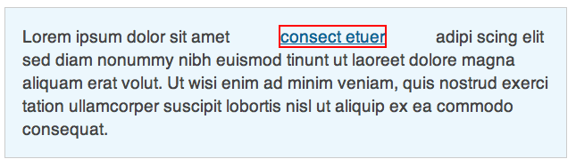
Inline elements and margin
Only left and right margin is applied to an inline element

Slide 83
CSS
8
Padding

Slide 84
Padding
Creates a transparent space inside an element
Options
Length: fixed length
%
Inherit from the parent
Auto: browser will calculate a value

Slide 85
Inline elements and padding
Only left and right padding applied to inline elements

Slide 86
CSS
9
Floats

Slide 87
Probably the most understood property

Slide 88

Propably the most understood property
and therefore the most hated

Slide 89

Image floating left

Slide 90
CSS
10
Vendor Prefixes

Slide 91
To understand prefixes, let me tell you a story

Slide 92
“Once there was a box model
and that box model looked like this”

Slide 93
“And that box model had a few important properties”
WIDTH
HEIGHT

Slide 94

“And then suddenly came”

Slide 95

“And Microsoft said no to the box model”

Slide 96
“We have a better idea,
let’s create the intuitive box model”
WIDTH
HEIGHT

Slide 97

“And everybody felt like a crying baby”

Slide 98
“Years went by and
they couldn’t change their CSS support
because it would break a lot of sites”

Slide 99
“Solution, DOCTYPE switching.
They gave the solution a name: Quircks mode.
Now every browser needs to support 2 modes.”

Slide 100
“We the arrival of CSS3, prefixes can be used to say
that a specific feature is still in progress.
Each browser can now say that they are working
on the feature, but it is not finished and things can be fixes”

Slide 101

“And everybody felt like”

Slide 102
Not all the browsers support every feature yet. To mark a feature as work in progress, they use a prefix.
-webkit-border-radius: 12px;
-moz-border-radius: 12px;
-ms-border-radius: 12px;
-o-border-radius: 12px;
border-radius: 12px;
Not really needed

Slide 103
CSS
11
Naming Conventions

Slide 104
Filename
Underscore: never
Capitals: never
Hyphen/dash between segments, words
Points: never

Slide 105
Selectors
Underscore: never
Capitals: never
Hyphen/dash between segments, words
Points: when selecting classes as a first character

Slide 106
Properties
Write all properties in lower case
Good Practice:
.container-payments {
padding: 4px;
width: 200px;
}
Bad Practice:
.container-payments {
Padding: 4px;
width: 200px;
}

Slide 107
Colors
Write all colors in lower case.
Good Practice:
.container-payments {
color: #ffcc35;
}
Bad Practice:
.container-payments {
color: #FFCC35;
}

Slide 108
CSS
12
Border-Radius

Slide 109
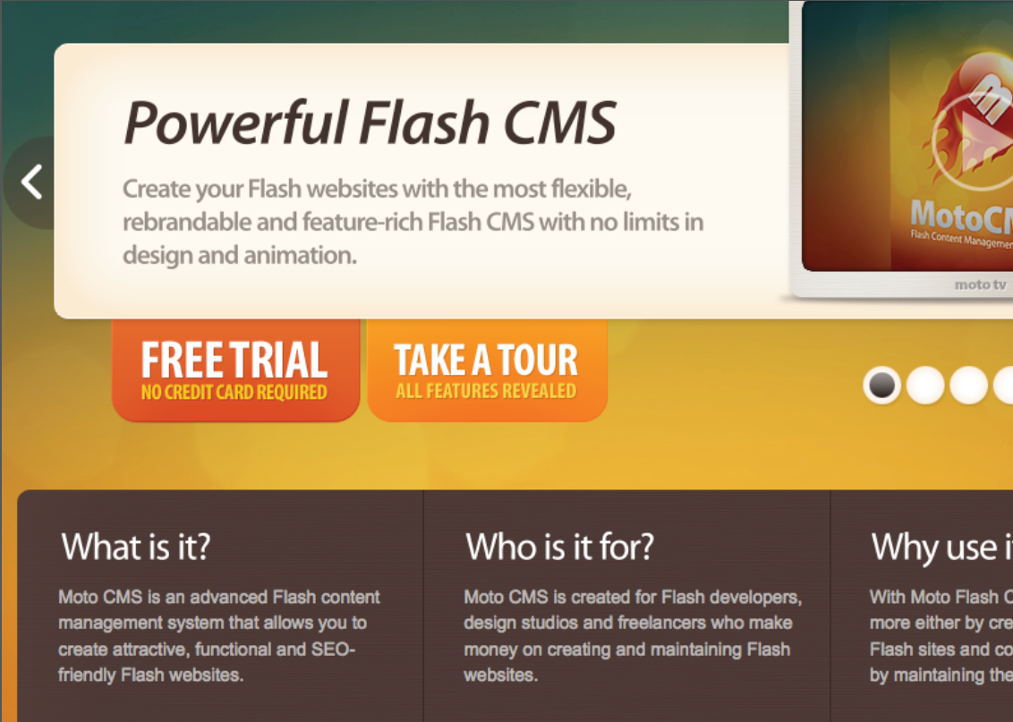

Slide 110
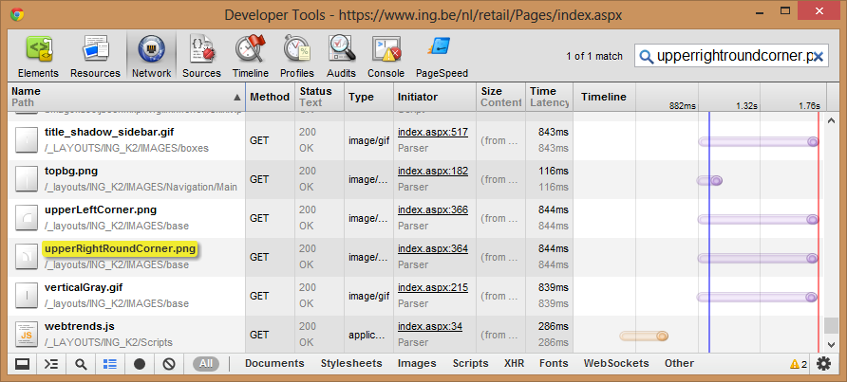

Slide 111


Slide 112

5
30
border-radius: 5px 30px 50px 80px;
80
50

Slide 113
CSS
12
Responsive Design

Slide 114


Slide 115
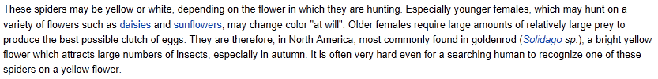
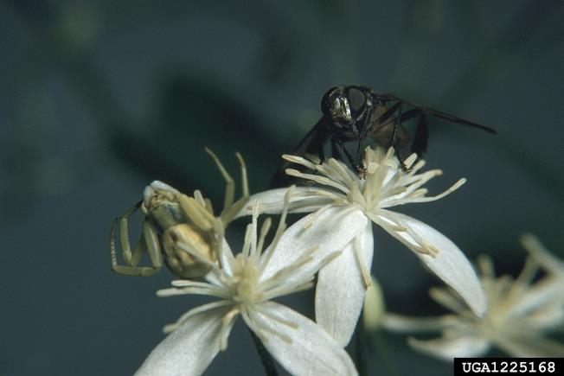
Pictures of M. vatia

Slide 116

Pictures of M. vatia

Slide 117


Slide 118
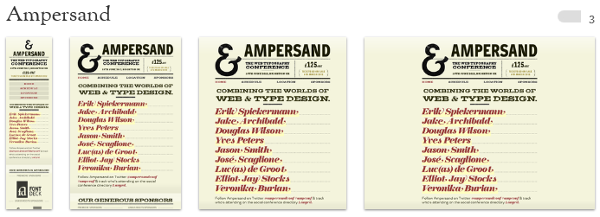

Slide 119
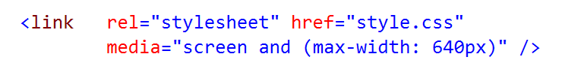
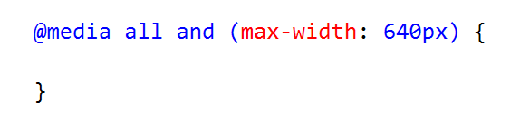
1.
2.
3.

Slide 120
MEDIA QUERY
Type
Query of Expression
@media all and (max-width: 640px) {
}

Slide 121
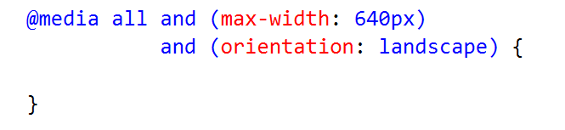

Slide 122
CSS
12
Style Conventions

Slide 123
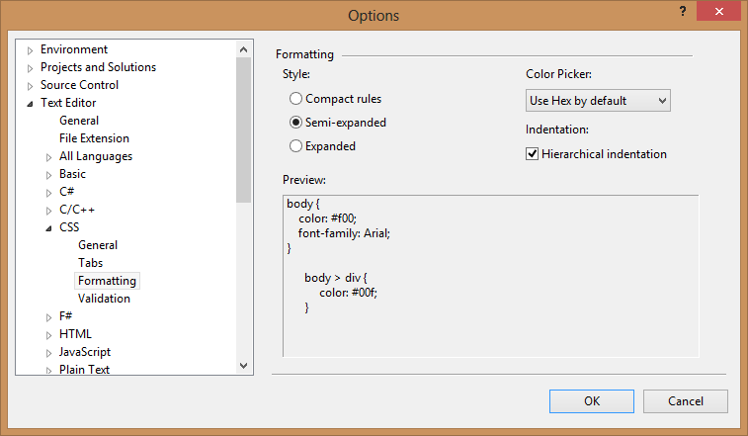
Formatting

Slide 124
Indentation
Indent your code for readability and maintainability
All CSS statements should be indentend one level
No special indentation for vendor prefixes

Slide 125
Indentation
One indentation level equals 4 spaces
Good Practice:
.container-payments {
color: #ffcc35;
}
Bad Practice:
.container-payments {
color: #FFCC35;
}

Slide 126
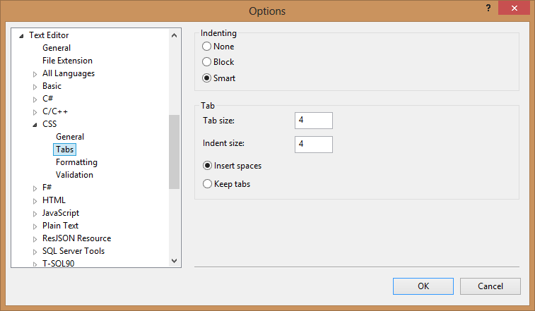
Indentation

Slide 127
CSS Statement rules
Have no space between property and “.”
Have a space between the “.” and the value
Have only one space between different values
End with a semicolon
Be on a separate line

Slide 128
Indentation
Good Practice:
.some-div {
border: 1px solid #000000;
padding: 2px;
color:black;
}
Bad Practice:
.some-div {
border: 1px solid #000000;
padding: 2px;color:black;
}

Slide 129
Shorthand notation
Use shorthand properties when possible to minimize the size of your CSS files.
Good Practice:
border: 1px solid #000000;
Bad Practice:
border-style: solid;
border-color: #000000;
border-width: 1px;

Slide 130
Shorthand notation
Use shorthand notation on
Background
Margin and padding
Don’t use shorthand notation on
Font: property is inherited which could bring confusion
List-style: same as font

Slide 131
Shorthand notation
Good Practice:
margin: 20px;
padding: 0 5px 1px 0;
Bad Practice:
padding-top: 5px;
padding-bottom: 5px;
padding-left: 5px;
padding-right: 5px;

Slide 132
Multiple declarations
Within the CSS declarations, use multple declarations where possible.
Good Practice:
Bad Practice:
p {
margin: 20px;
color: #ff0000;
}
p {
margin: 20px;
}
p {
color: #ff0000;
}

Slide 133
Group context-related styles
Good Practice:
header {
}
header nav {
}
.main {
}
.main article {
}

Slide 134
CSS
13
Development Guidelines

Slide 135
Avoid ID’s
For reusability, use classes instead of id’s.
Good Practice:
.payments {
}
Bad Practice:
#payments {
}

Slide 136
Avoid Elements
For reusability, use classes instead of elements, some elements can share same style
Good Practice:
.payments {
}
Bad Practice:
input.payments {
}

Slide 137
Reset mechanism
A CSS reset will “reset” all default HTML elements to default styles
Use normalize.css

Slide 138
INHERITANCE INHERITANCE INHERITANCE
CSS stands for Cascading Style Sheet
Allows you to write less code
Leads to smaller files which is more performant
Makes your code maintainable

